Slide 1



Presented by: Group no.- 9(G6) Neharika Goswami(2021A1L001) Himanshi Tickoo (2021A1L009) Simran Raina (2021A1L013) Agrima Sharma (114-CSE-17) Branch-CSE Subject-Computer Network Lab (COM-512) TOPIC- Network Topologies Using Switches And Routers
Model Institute of Engineering & Technology

Slide 2
CONTENTS
S.NO. | TOPICS
1. | INTRODUCTION
2. | TOPOLOGY USED-HYBRID TOPOLOGY
3. | TYPES OF TOPOLOGY
4. | DEVICES AND MACHINES USED
5. | DEMONSTRATION
6. | CONCLUSION
7. | REFRENCES

Slide 3
INTRODUCTION
What is a network topology?
A network topology is the physical and logical arrangement of nodes and connections in a network. Nodes usually include devices such as switches, routers and software with switch and router features. Network topologies are often represented as a graph.

Slide 4
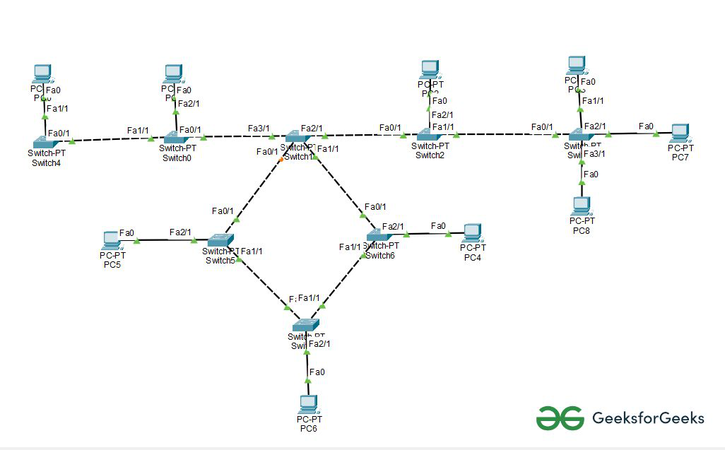


TOPOLOGY USED- HYBRID TOPOLOGY
This topological technology is the combination of all the various types of topologies. It is used when the nodes are free to take any form. It means these can be individuals such as Ring or Star topology or can be a combination of various types of topologies. Each individual topology uses the protocol.
Hybrid Topology

Slide 5
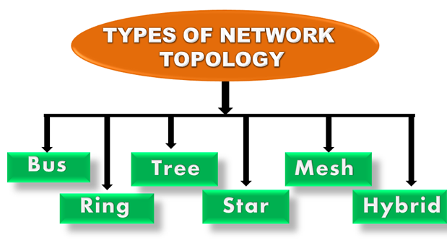
TYPES OF TOPOLOGY

Slide 6
Mesh Topology: In a mesh topology, every device is connected to another device via a particular channel. In Mesh Topology, the protocols used are AHCP (Ad Hoc Configuration Protocols), DHCP (Dynamic Host Configuration Protocol), etc.
Star Topology: In star topology, all the devices are connected to a single hub through a cable. This hub is the central node and all other nodes are connected to the central node.
Bus Topology: Bus topology is a network type in which every computer and network device is connected to a single cable. It is bi-directional.
Ring Topology: In this topology, it forms a ring connecting devices with exactly two neighbouring devices. A number of repeaters are used for Ring topology with a large number of nodes.
Tree Topology: This topology is the variation of the Star topology. This topology has a hierarchical flow of data. In Tree Topology, protocols like DHCP and SAC (Standard Automatic Configuration) are used.

Slide 7
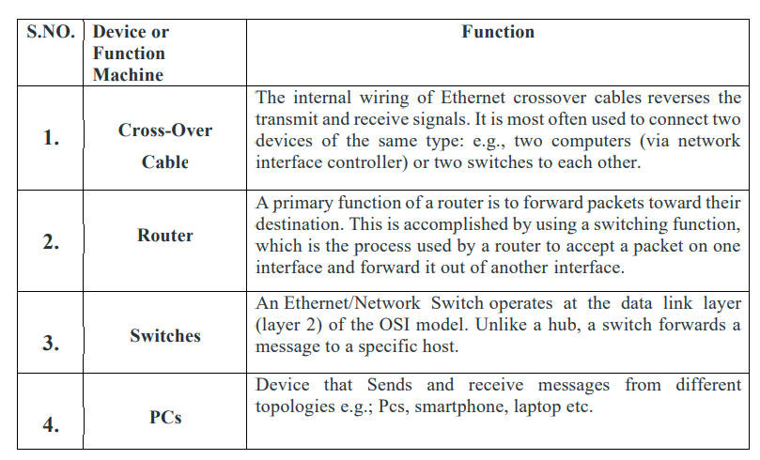
DEVICES AND MACHINES USED FOR DESIGN

Slide 8
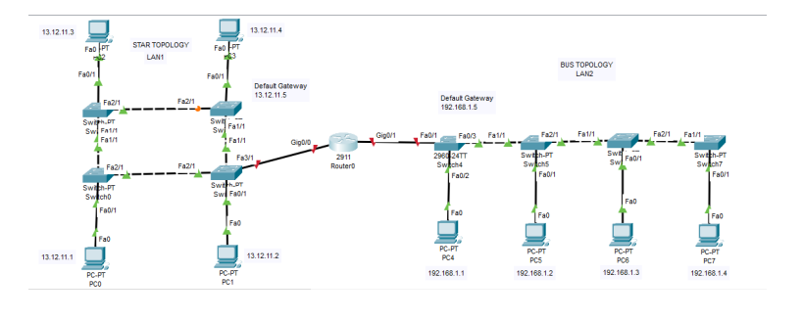
DEMONSTRATION
Step 1: The Network Topology is established between router, switches and further with PCs.

Slide 9
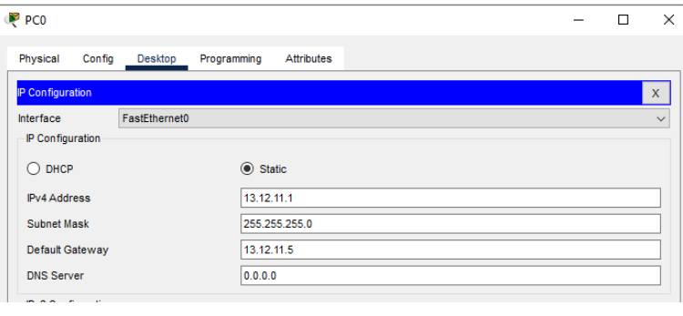
Step 2: Configure the PCs (hosts) with IPv4 address, Subnet Mask, and Default gateway according to the IP addressing. Repeat the same Procedure with PCs of LAN2 to configure them.

Slide 10
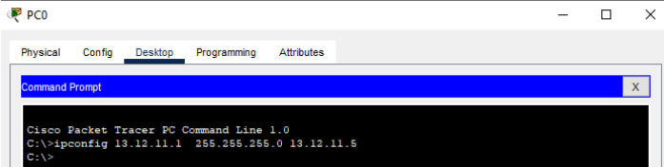
step 3: Assigning IP address using the ipconfig command. Repeat the same procedure with other PCs of Both LANs to configure them thoroughly.

Slide 11
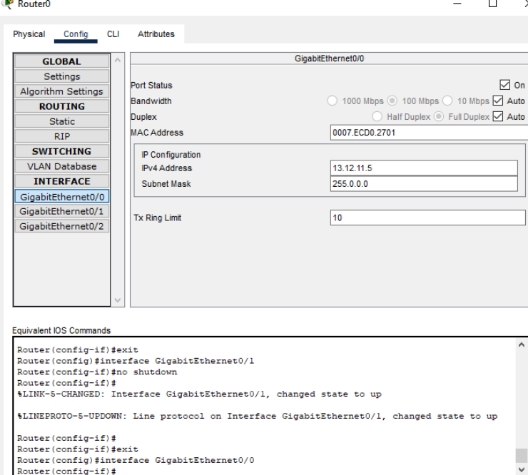
Step 4: Configure router with IP address and subnet mask.

Slide 12
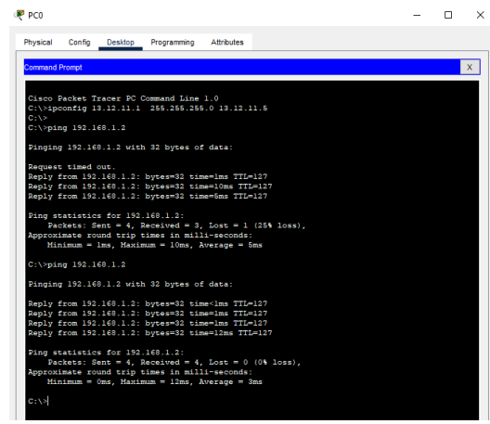
Step 5: Verifying the network by pinging the IP address of any PC. We will use the ping command to do so.

Slide 13
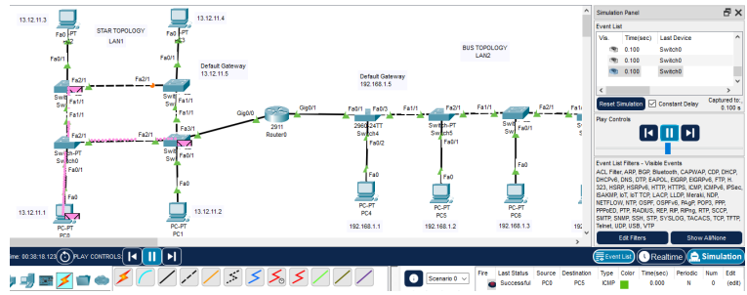
Step 6: In simulation, the cables are connecting the devices with others and we are getting replies which means the connection is working properly.

Slide 14
Conclusion
It proves to be more flexible, reliable, effective and scalable than other networking topologies but at the same time difficult to manage and costly also. Although its complex structure can create hazards due to its robust and effective features gained a lot of popularity. The Network of topology differs from place to place. If the server problem occurs server gets down, Then topology faces its failure.

Slide 15
References
https://www.geeksforgeeks.org/connection-between-ring-and-bus-topology-in-cisco/?ref=rp
https://www.geeksforgeeks.org/types-of-network-topology/
https://www.javatpoint.com/computer-network-topologies

Slide 16
THANK YOU

